Slide 1

Website

Slide 2
Navigation of the website - examples
https://www.zsl.org/zsl-london-zoo - Tab/Responsive Navigation Menu (https://codemyui.com/css-only-responsive-navigation-menu/ )
https://www.zsl.org/zsl-whipsnade-zoo - Tab/Responsive Navigation Menu (https://codemyui.com/css-only-responsive-navigation-menu/ )
https://www.chesterzoo.org/ - Stretch and expand navigation – to show which link is active (https://codemyui.com/stretch-and-expand-underline-on-click-navigation/ & https://codemyui.com/active-link-indicator/ ) - The most popular and the most professional. My suggestion.
Additional
Dropdown menu - https://codemyui.com/css-only-simple-drop-down-navigation-menu/
Tab Navigation Menu And Hero Section Slider - https://codemyui.com/accordion-tab-navigation-menu-hero-section-slider/ - A step further from London and Whipsnade zoo)

Slide 3
Layout of the website - example
Competitors
1. Regents Park’s Zoo – The London Zoo – London
https://www.zsl.org/zsl-london-zoo
2. Chester Zoo – Cheshire
https://www.chesterzoo.org/
3. Whipsnade Zoo, Dunstable – Bedfordshire
https://www.zsl.org/zsl-whipsnade-zoo
My idea:
https://claybrookzoo.squarespace.com/config/

Slide 4
Displaying information about critical zoo animals on the website - example
See PowerPoint

Slide 5
Kiosk

Slide 6
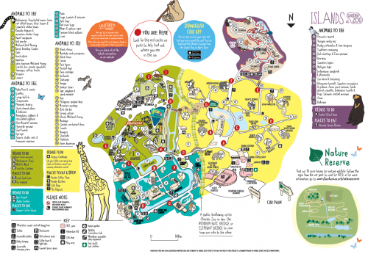
Map

Slide 7
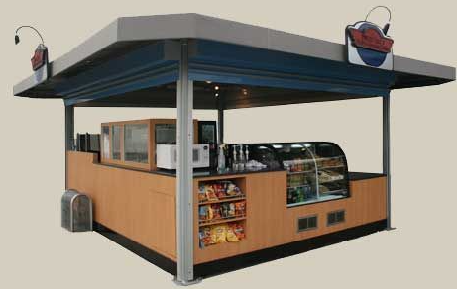
Kiosk design
Potential sales:
- cold food
-warm food
-add vending machines
- sponsorship banner
- merchandise from the zoo
- Information board

Slide 8
Cold Food | Warm Food
sandwiches | Burgers
candy | Soups
snacks | Soul Food
Ice cream

Slide 9
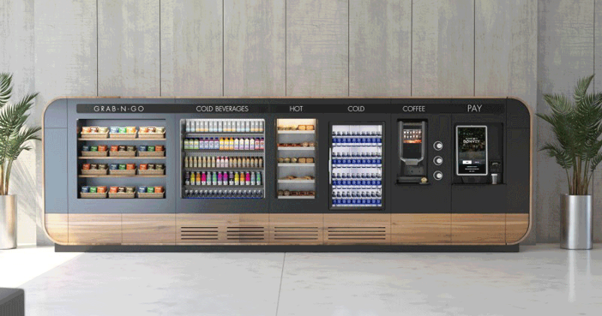
Vending machines

Slide 10
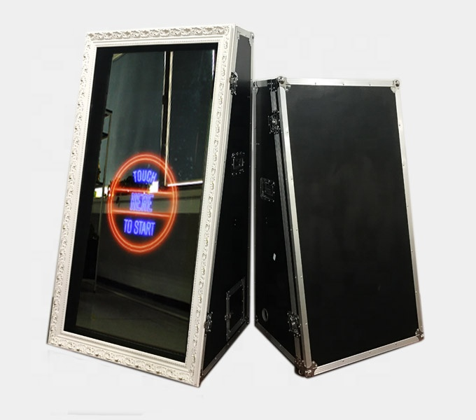
Sponsorship
Magic mirrors to take pictures of the people at the zoo,
Dotated with the sponsors logo
Low prices per picture to attract more people
Pictures are printing of the back of the card the sponsor and zoo logo

Slide 11
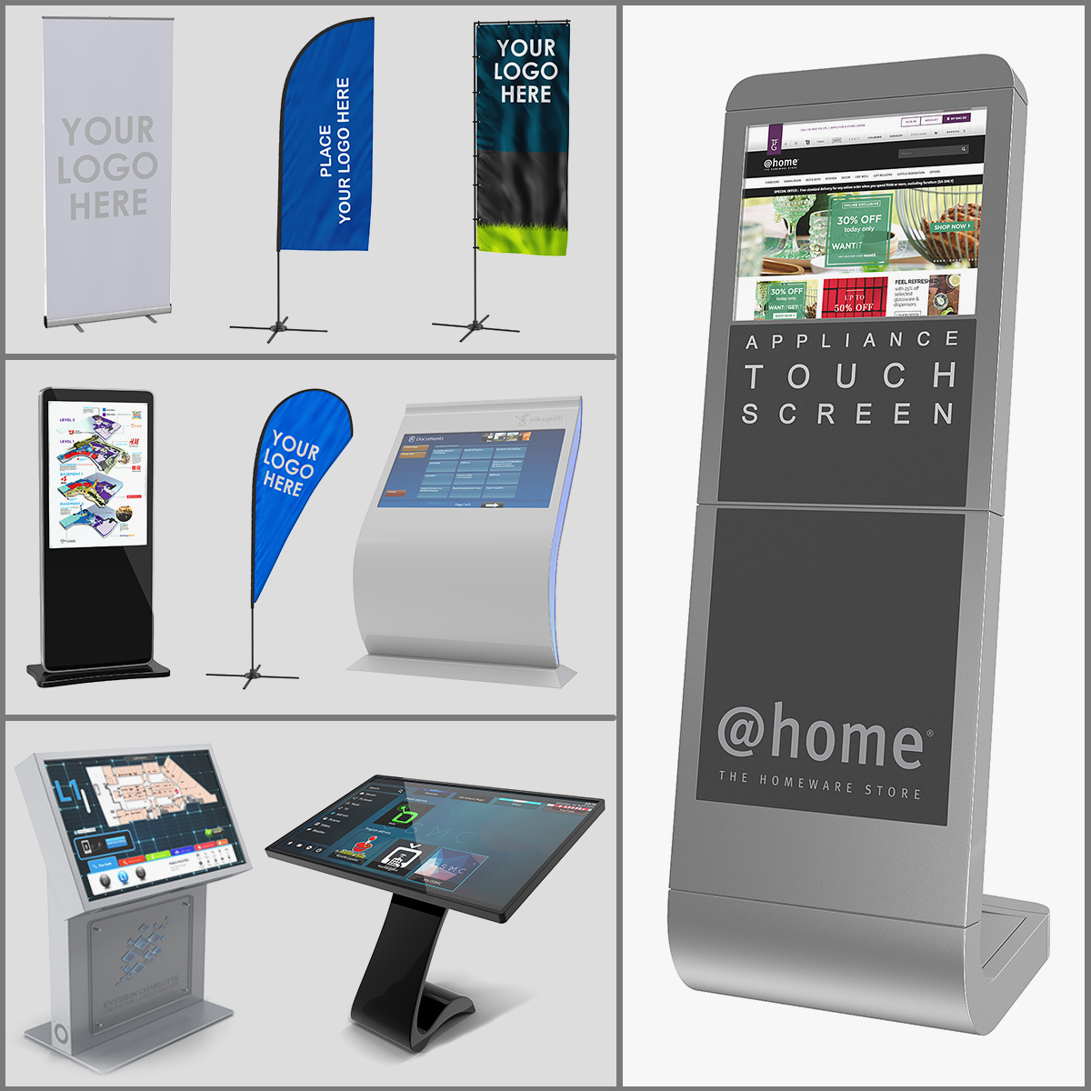
Additional ideas for sponsorship info points and banners

Slide 12
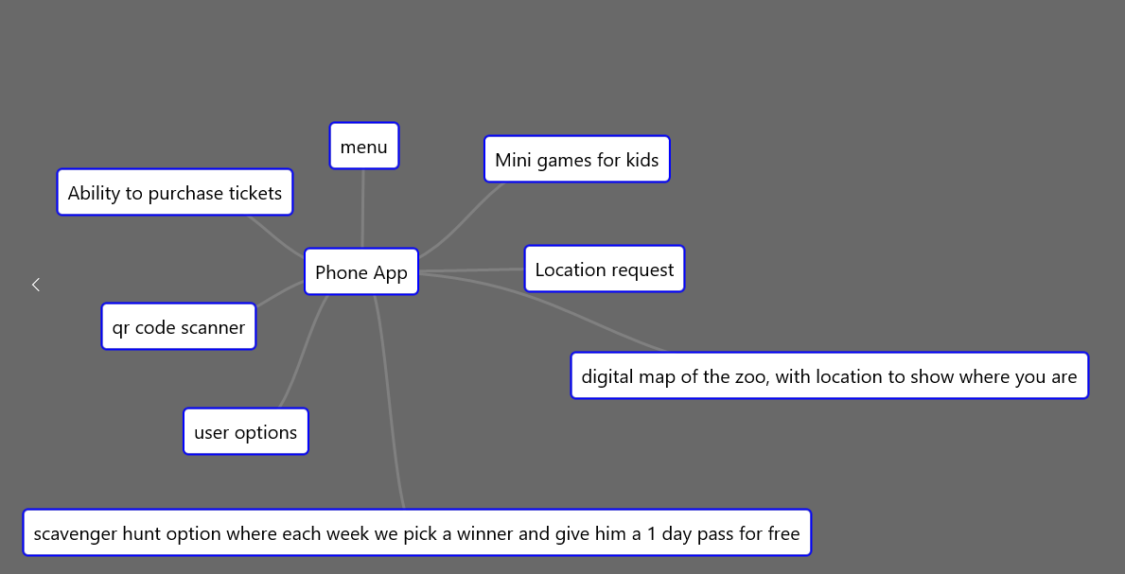
Mobile app
Responsive
Digital map with location
Menu

Slide 13
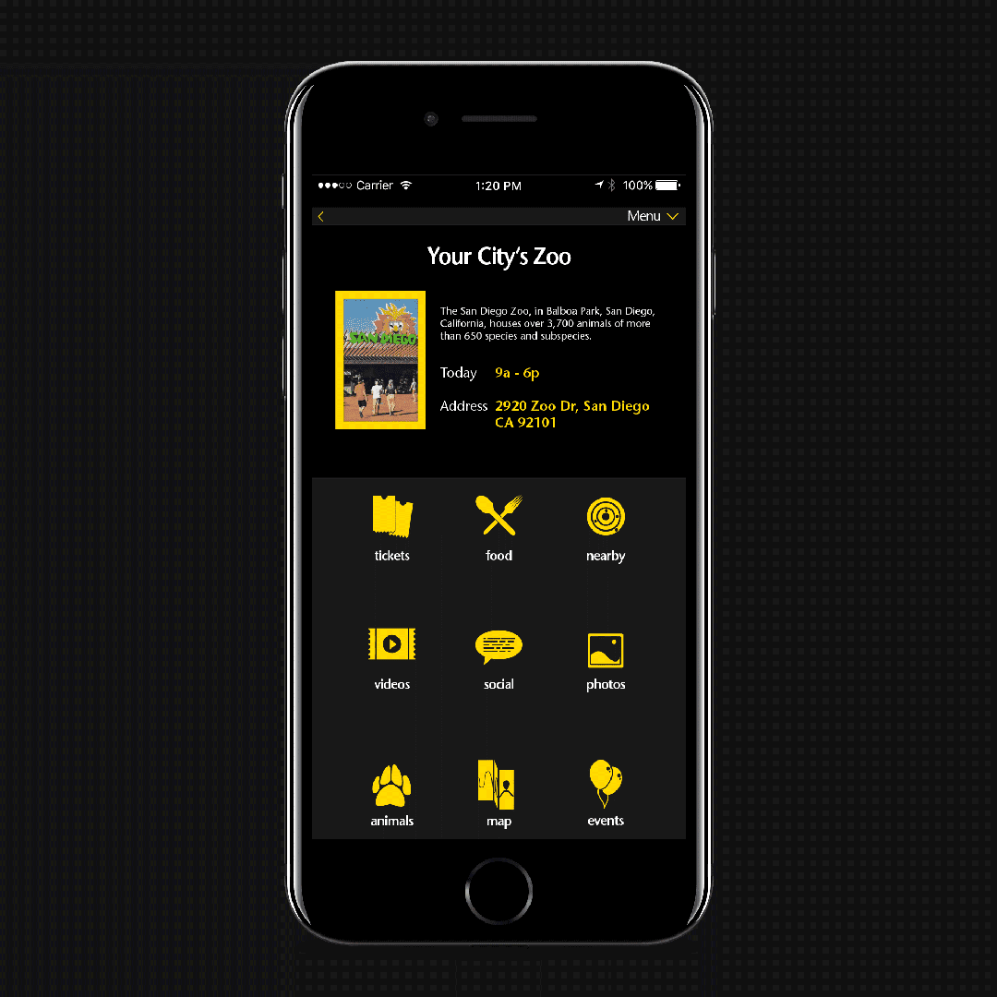
Menu

Slide 14
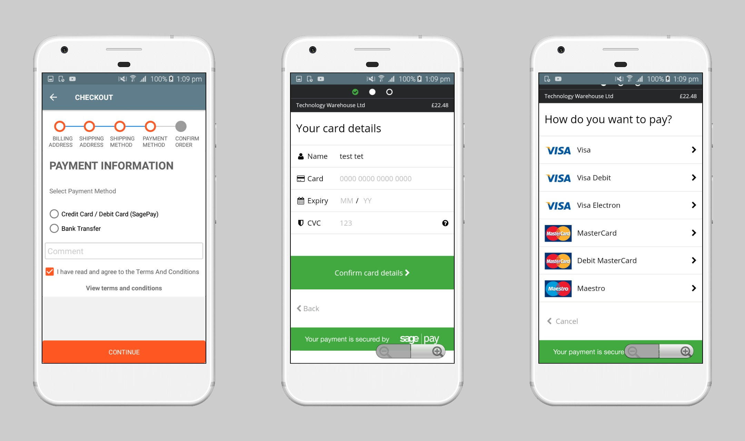
Ability to purchase tickets
Setup gateway
Multiple products:
- one person purchase
-student discounts
-elderly discounts
-children discounts
Large groups discounts
Ability to rent the zoo for events

Slide 15
Digital map of the zoo
Location based map
3D environment map
Interactive map with small animals running around
Show approximate location of the scavenger hunt games

Slide 16
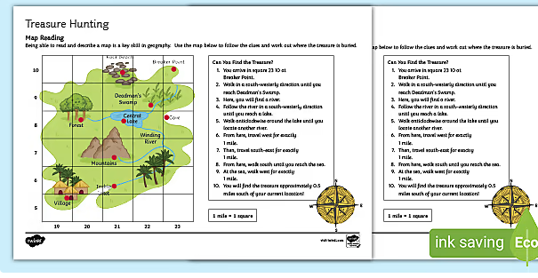
Scavenger hunt game
Each part of the park will have hidden clues
High score board within the app
Weekly challenges
Every week we will pick out a person and give them a free one day pass
Ability to stamp the cards for children

Slide 17
User option
Create users within the app
User can check what he visited
Ability to offer from time to time free passes to the users that are frequent visitors

Slide 18
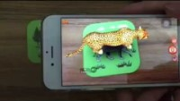
QR code scanner
The kiosk will sell small cards with a qr code on the back, when scanned in within the app, the person can see a 3D version of the animal they have brought
At the back, it will show the sponsor logo and zoo logo

